Slide 1
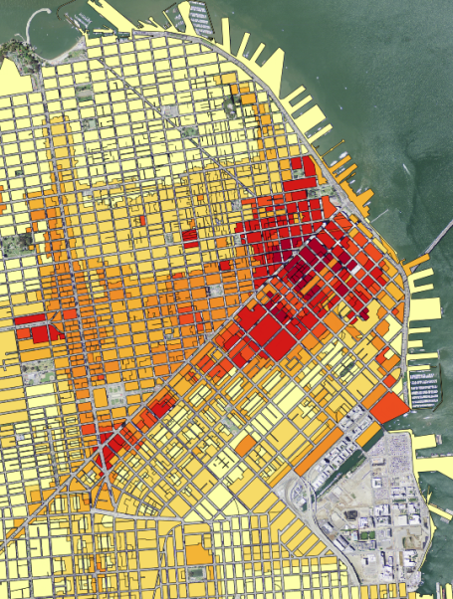

Intro to PostGIS
Daniel Caldwell

Slide 2
What is PostGIS
Extension to PostgreSQL
Provides Spatial Types
Provides Spatial Functions

Slide 3
History of PostGIS
2001 - Refractions Research Releases PostGIS
2003 – GEOS is released
2005 – Version 1.0 Released
2006 – OGC registered PostGIS as implementing SFSQL Specification
2006 - Move from the OpenGIS design guide to the SQL/MM document. ST_ naming conventions added.
2010 – Geography Types Released
2012 – Verson 2.0 Released adding more 3d support, geometry repair, and other functions
October 2015 – Version 2.2.0 released

Slide 4
Things you need to know
Coordinate Systems
Geometries
Spatial Functions

Slide 5
Geometries
Geometry
Coordinate System
GeometryCollection
Point
MultiPoint
LineString
MultiLineString
Polygon
MultiPolygon
There are other geometries for curves, 3d, and measure values

Slide 6
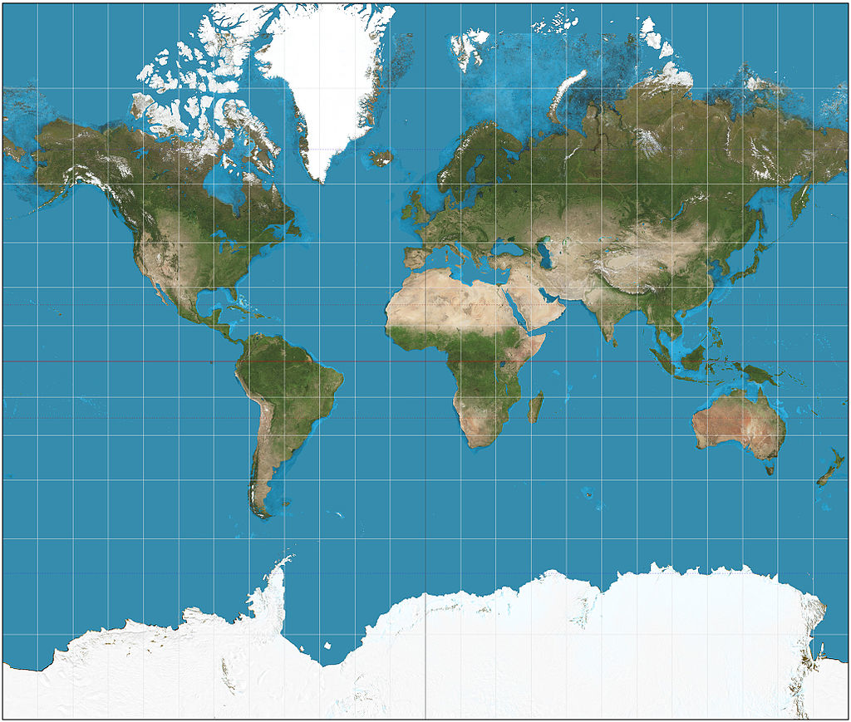

Coordinate Systems

Slide 7

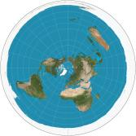

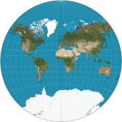

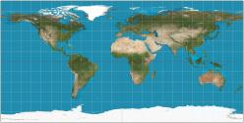
Projections

Slide 8
Coordinate System
Helpful Questions to Ask when looking at data
Is it geographic or projected?
If it is geographic is the system 0-360 or -180 to 180?
Where is 0,0?
If it is projected, what are the linear units?

Slide 9
Setup Machine Demo/Exercise
Using the Virtual Machine:
SSH into the vagrant machine: ‘vagrant ssh’
Go to /vagrant/data folder: ‘cd /vagrant/data/01_create_database
Option 1
Run scripts to create the database and verify the extensions are installed correctly
Extra: Connect to PostgreSQL using QGIS
Using AmigoCloud:
Create a project
Create an advanced query to check PostGIS Version
Look at Script 03_test_postgis_version.sh for the query

Slide 10
Importing Spatial Data
shp2pgsql
GDAL (ogr2ogr)
QGIS

Slide 11
Importing Data Demo/Exercise
Scripts and Data are under the 02_ImportDataUsingOgr directory
Vagrant Machine
Run scripts in order to do the following
Look at the properties of the shapefile
Import them into the PostgreSQL Database as is
Check the properties of the Database Table’s geometries
Import them again using ogr2ogr to assign/transform the coordinate system to WGS_1984 (4326)
Use PostGIS to do the same thing as ogr2ogr did on import. Note that they both use Proj4!
Check the properties of the PostgreSQL database
AmigoCloud
Upload the state and city data using the zip files
Run query to identify the spatial reference the data is stored as.
Note that AmigoCloud doesn’t maintain the name of the table. It will be dataset_#####. This is to enable AmigoCloud’s REST API to uniquely identify a dataset.
Look in 04_cities_postgresql_info.sh for the cities query
Look in 09_states_postgresql_info.sh for the states query

Slide 12
Geometry Validity
Invalid geometries cause problems with spatial operations.
Simple (multipoint and line strings)
no anomalous points (multiple vertices or points at the same place)
No self intersection (loops or figure 8)
No self tangency
Valid (polygons)
No overlapping rings
Interior rings are fully enclosed in the exterior ring
No cut rings
No spikes

Slide 13
Simple vs Not Simple

Slide 14
Valid vs. Invalid

Slide 15
Repair Geometry Demo/Exercise
Queries and data are under the 03_CheckingData directory.
Vagrant Machine
Import or create the polygon_test table in the PostgreSQL database
Connect using psql to check for invalid geometries (02_test_validity.sh)
Fix the invalid geometries (03_fix_validity.sh)
Check again to make sure they are repaired
AmigoCloud
Upload the polygon_test zip file.
Notice that the preview image may be incorrect and the data may render wrong in the dataset view.
Use advanced queries to identify and repair the invalid geometries. (02_test_validity.sh and 03_fix_validity.sh)

Slide 16
Scenario 1: Identify all Manholes along a street
Geography (meters) vs Geometry (Decimal Degrees)
ST_BUFFER
ST_UNION
ST_INTERSECTS

Slide 17
Demo/Exercise
Queries and data are under 04_FindManholes directory
Virtual Machine
Import the manholes and streets
AmigoCloud
Upload the manholes and streets using the zip file
Both systems
Find street features
Buffer street features
Union buffered geometries
Intersect the single geometry against the manholes

Slide 18
Scenario 2: Identify the closest fire hydrants
ST_DISTANCE
Use Geography to see distance in meters

Slide 19
Demo/Exercise
Scripts and data are under the 05_FindHydrant directory
Virtual Machine
Import the hydrant data and business data using the scripts
AmigoCloud
Upload the hydrant data and business data using the zip files.
Both Systems
Select the business 'INFUZON OF THE CASKROOM’ using SQL
Select it’s wkb_geometry
Select the hydrants and the distance to that geometry. Use ST_Distance.
Order and limit the query to the closest three

Slide 20




TileStache
Webserver requests tile from TileStache
TileStache gets image from disk or requests from provider
User requests tiles
Standard URL format: http://server/layer/{z}/{x}/{y}.<extension>

Slide 21

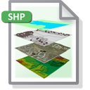
Mapnik
User requests image
Mapnik requests Data from Data Sources. Styles the data and returns image.

Slide 22
Demo/Exercise
Scripts and data are under the 06_RenderTiles directory
Vagrant
Review TileStache config file.
Review Mapnik XML File
Run Scripts for running a tile server.
Change color in Mapnik XML and rerun
AmigoCloud
Make dataset public
Review URL and data
Change color in dataset’s styling pane and review the change in your public map

Slide 23
Further Resources
PostgreSQL (http://www.postgresql.org/)
PostGIS Extension (http://postgis.net/)
GDAL (http://www.gdal.org)
TileStache (http://tilestache.org/)
Mapnik (http://mapnik.org/)
AmigoCloud (http://www.amigocloud.com/)
Neat projections courtesy of Mike Bostock (http://bl.ocks.org/mbostock/3711652)

Slide 24


Thanks!
Daniel Caldwell
daniel@danielcaldwell.com
_DanielCaldwell

